Slide 1
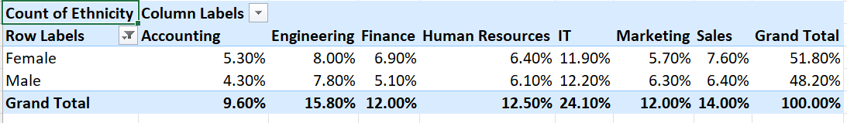
Task1
They asked the summary of gender ethinicity in the company
I took the pivot table and to find the ethnicity in the company so consider the overall company I took for description departments as column
I took the gender in rows to classify
And the female ethnicity is 51.8%

Slide 2
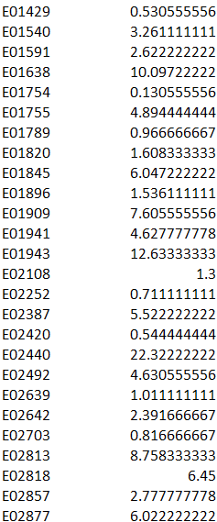
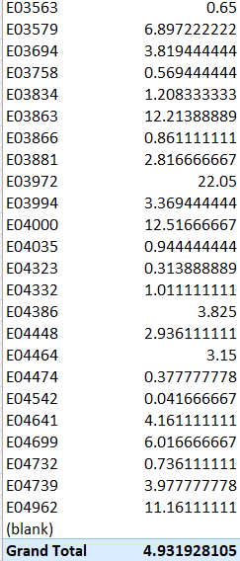
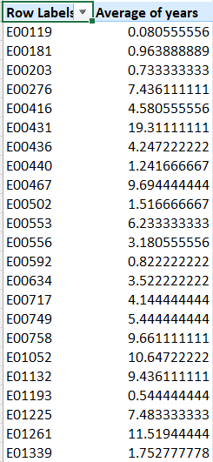
Task-2
->they asked for average years they existed before exit so t took eeid and years between hire date and exit date

Slide 3
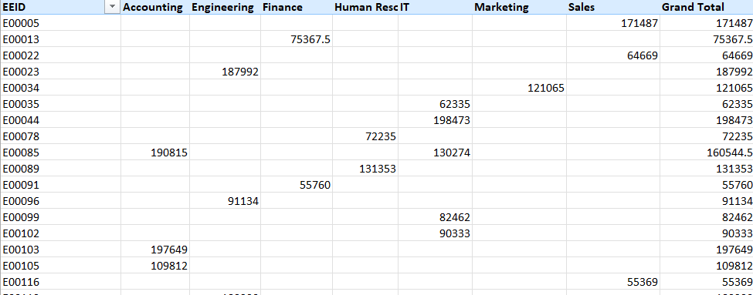
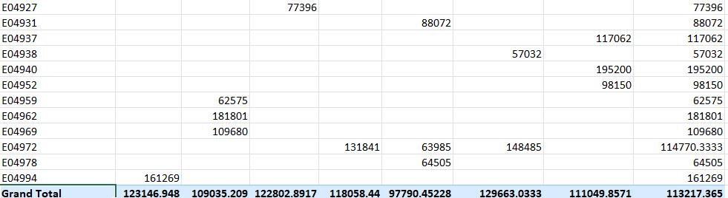
Task-3
->they asked that there is any difference betweendiffernce in average

Slide 4
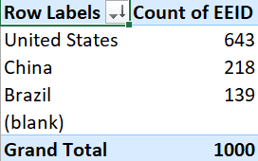
Task-4
United states has the more employee count

Slide 5
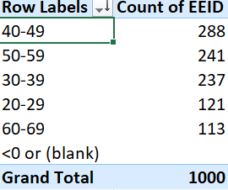
Task-5
More employees belonged to40-49 age

Slide 6
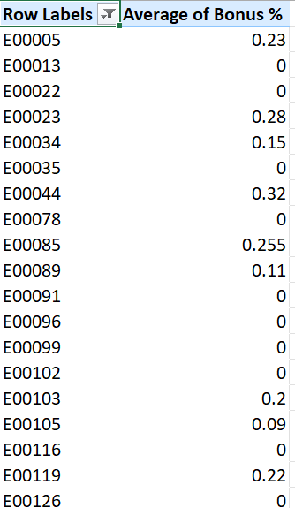
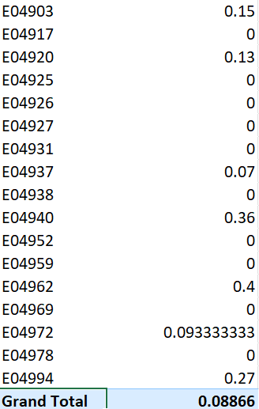
Task -6
The average years stayed by the employee incomplay before exit is -.-8866

Slide 7
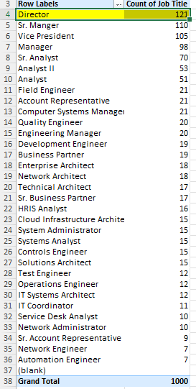
Task-7
The job title most ouccured is director

Slide 9
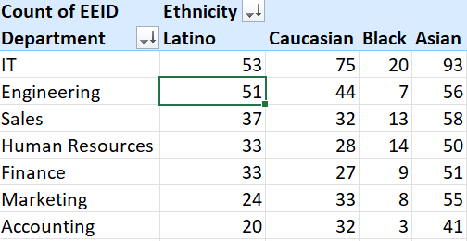
Task-9
Gender ethnicity is more in it department

Slide 10
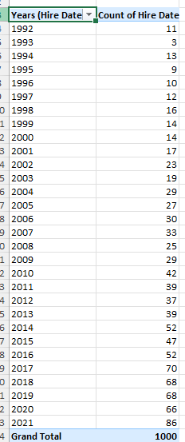
Task-10
The hires is increasing gradually

